Slide 1
Lent Week 5 Presentation

Slide 2
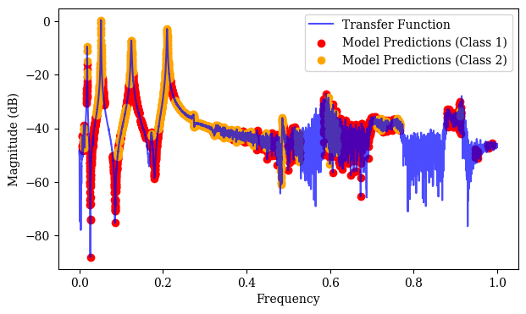
Tried training with log magnitude again, more parameters.
Good performance on generated data but poor performance on lab data
Seems like including log magnitude as a feature leads to the ‘banded’ predictions

Slide 3
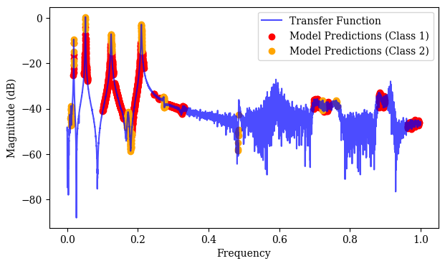
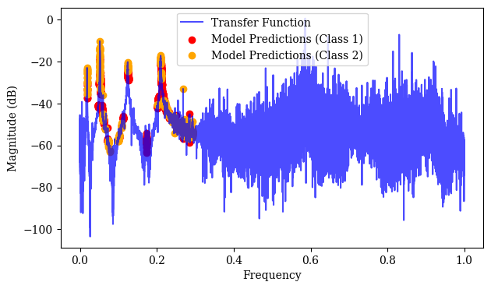
Excluding log mangnitude as a feature again yields better performance
Trained with data of longer length (300 vs 200)
Overpredicting class 2 but detecting all relevant features

Slide 4
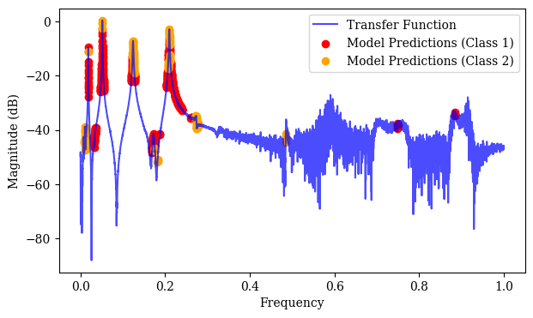
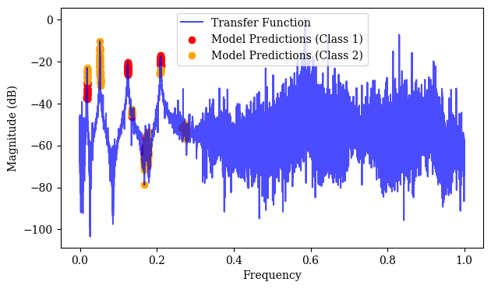
Further Training

Slide 5
Also started sampling at the same time
Havent yet looked into different methods, just used EMCEE to start with
Used an example transfer function with user defined prior bounds to test behaviour
Had to pass log standard deviation of noise as a parameter to avoid result being negative
Treat noise variance as a parameter to infer also (but need to look at how to do this properly)

Slide 6
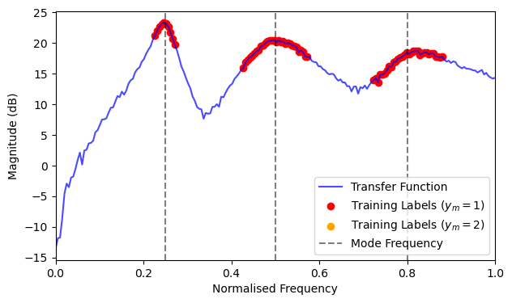
Transfer Function Used
3 modes, not too much noise
Priors on natural freq of width 0.2, priors on amplitude of size 1, priors on zeta from 0 to 0.2

Slide 7
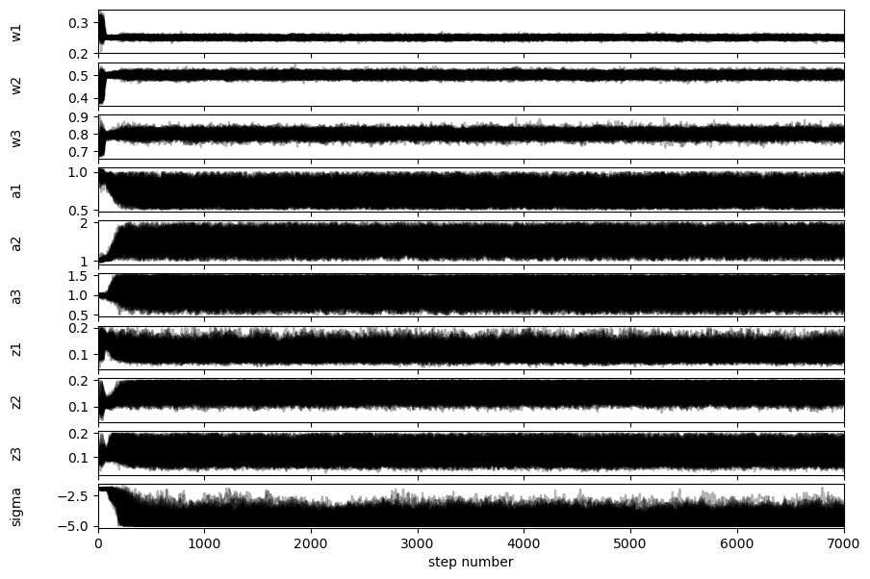
200 walkers, 7000 samples each. Raw samples converge to correct values in natural freqs but explore large ranges for modal amplitude and zeta.
Log(sigma) is strange -> need to investigate

Slide 8
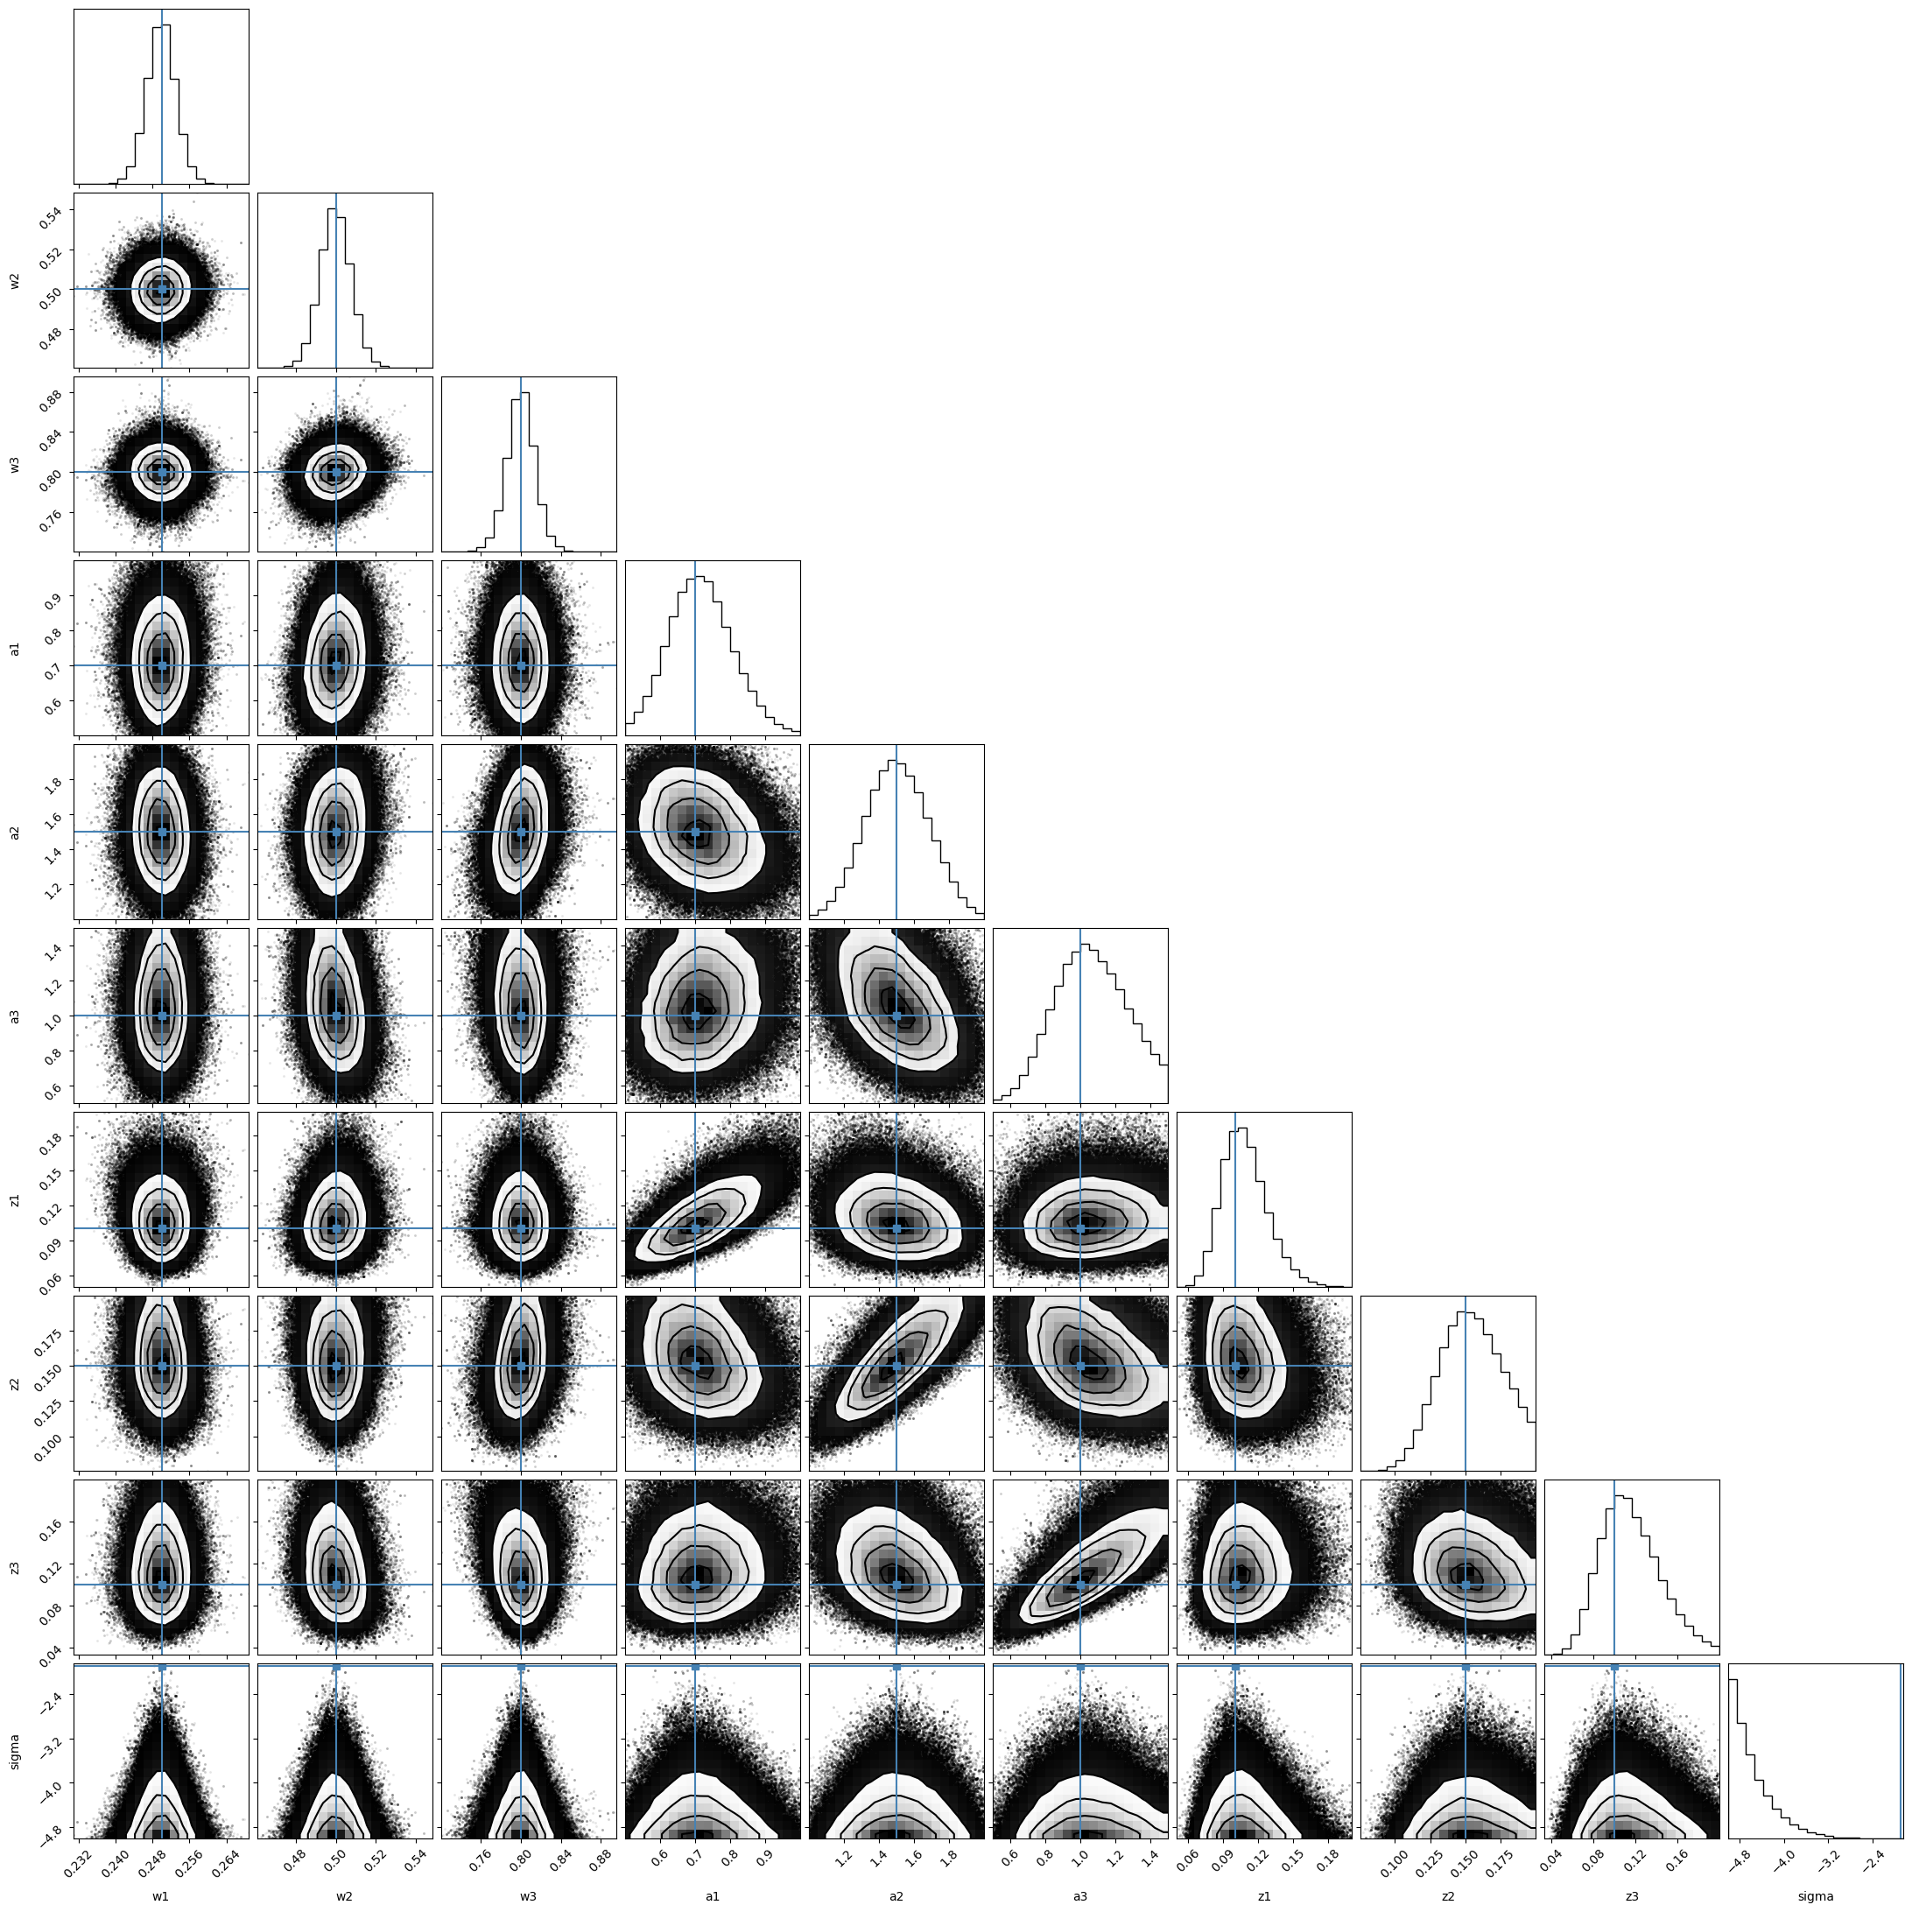

Slide 9
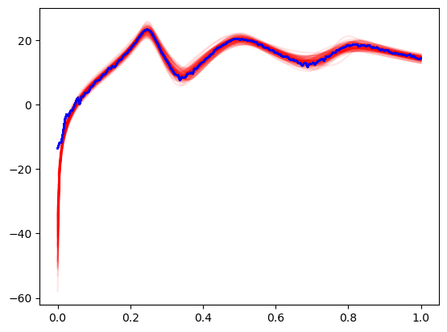
100 random posterior samples

